Slide 1


Slide 2

SMART RAILWAY SYSTEMS
By
BOLLAM HARISHMA REDDY- 20955A0208
THOTA SAI PRASANNA- 20955A0235
KANDARAPU AJAYRAJ-19951A0204
SANGANI AKHIL-19951A0205

Slide 3
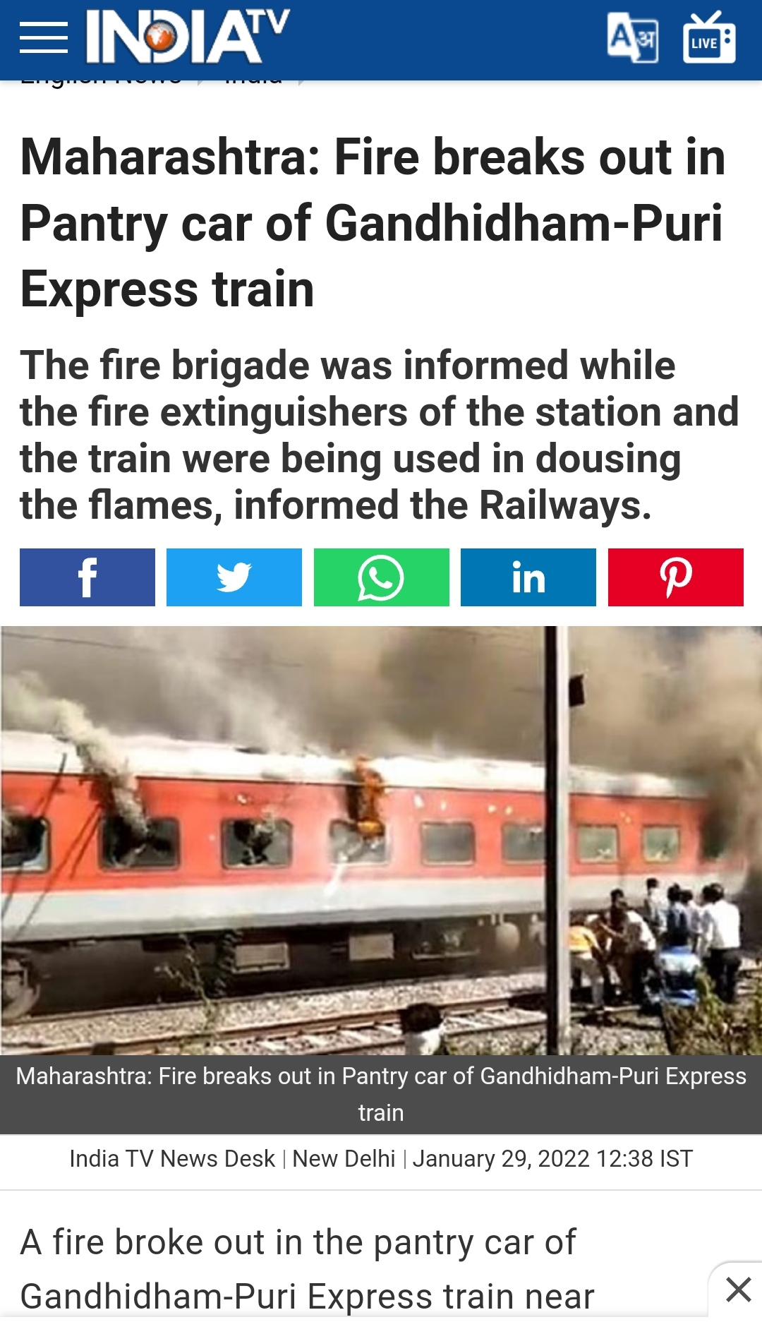
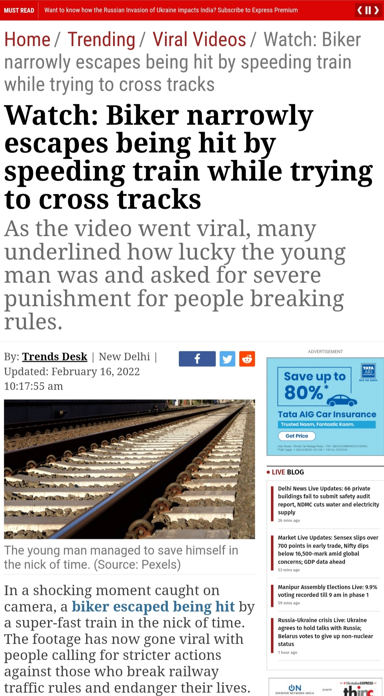
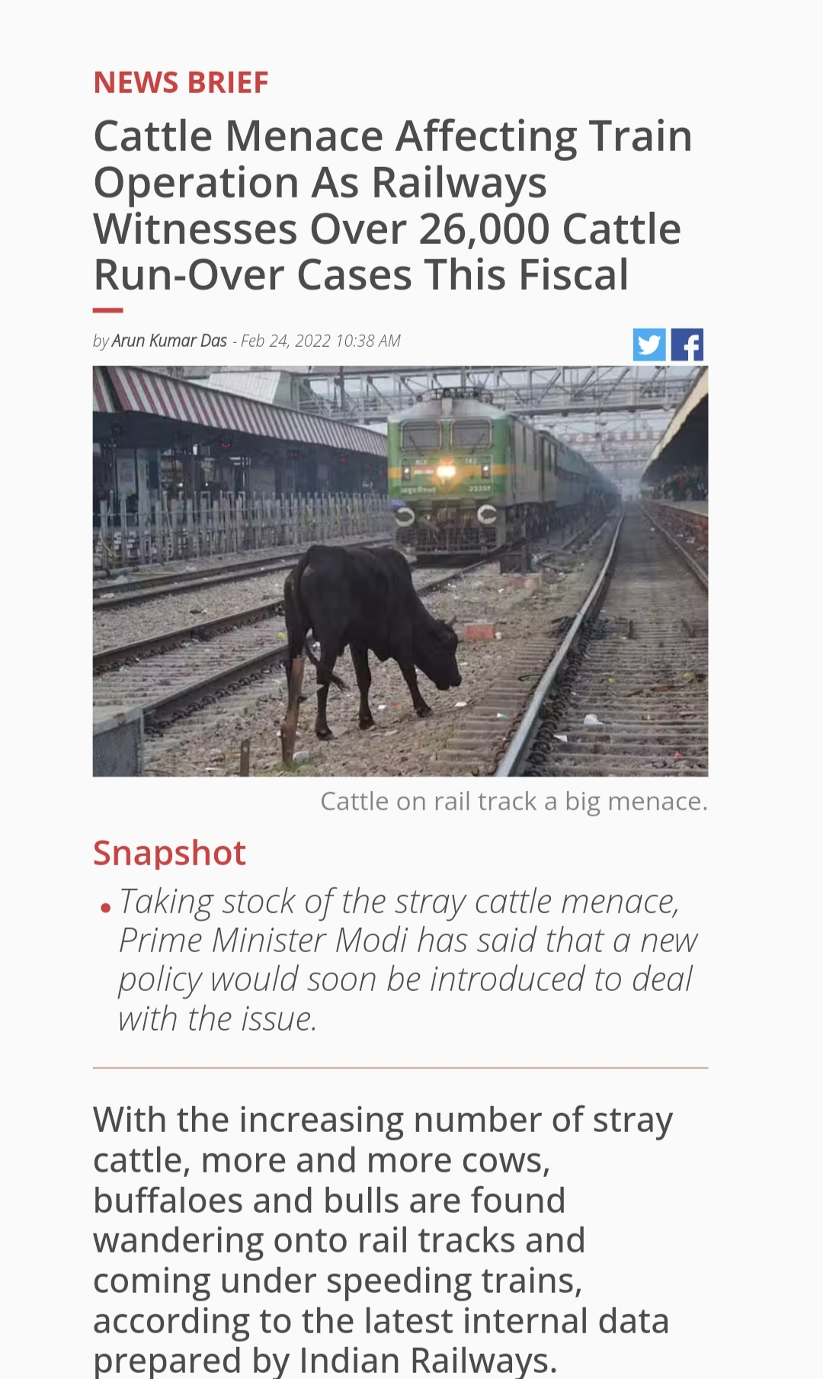
Articles

Slide 4
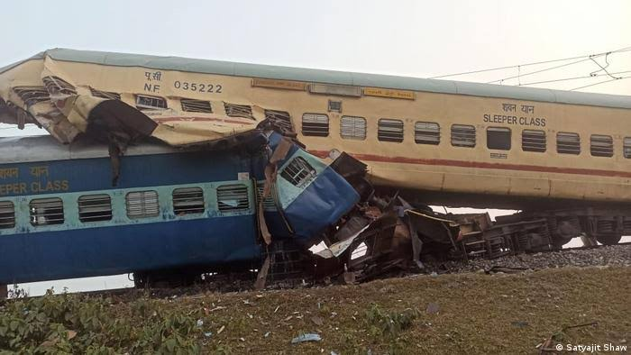
Smart railway systems
Railway safety is a crucial aspect of rail operation and it is the lifeline of India. it is being the cheapest modes of transportation and are preferred over all other means of transportation. Railroad accidents are major catastrophe, as they cause severe damage to life. Although rail accidents are very rare but once it happens it cause severe damage. Hence, we planned to propose a project which helps to railway administrations concerned to strengthen their safety and develop the safety measures. Security is an essential part of safety, from the physical protection of infrastructure, protection of people and other lives to the technology that safeguards the systems and information. Security is everyone's responsibility.

Slide 5
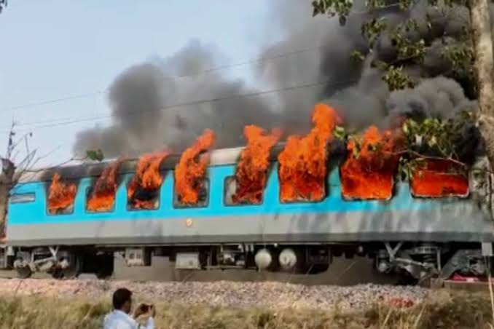
Railway system
Train accidents are uncommon in India . But unfortunately when these accidents occur, people are often seriously injured or even killed. Accidents involving trains are often the result of mechanical failures and human error, and often it’s a combination of both. There are a variety of different reasons that these railroad accidents occur, and some of these include:
• Accidental fire
Train derailment
• Improper maintenance of the train tracks
• Faulty equipment
• Collision with a car , bus or truck trying to cross train tracks
• Collapsed bridges
• Faulty train crossings

Slide 6
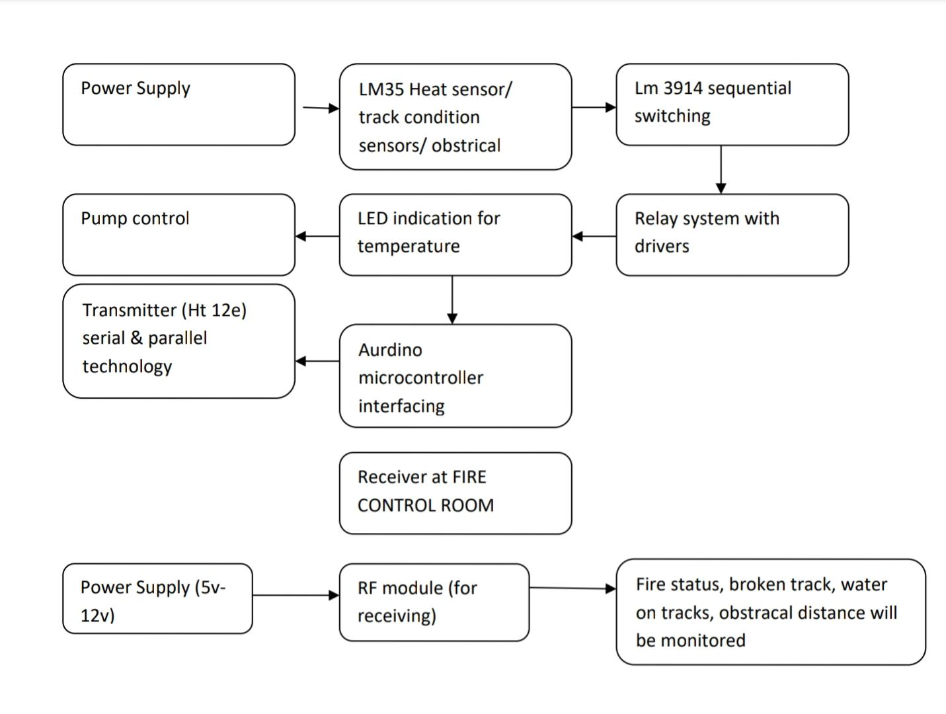
INTRODUCTION: TYPES OF ACCIDENTS AND ITS PREVENTION

Slide 7
Major Accidents
Accidental fire, it included four stages of fire detection and controlling fire in each coach using sensors, pump, siren etc. for train derailment and collapsed bridges used sensor to indicate the track position. Used sensor to sense the objects around 500m to indicate moving objects on track. Emergency facility arranged in each coach, emergency includes health issues and provided a button alongside the chain which sends message to nearby station and keep it ready with ambulance service. And when there are sudden floods or waterflow on tracks, the level of water indicated using moisture detectors

Slide 8
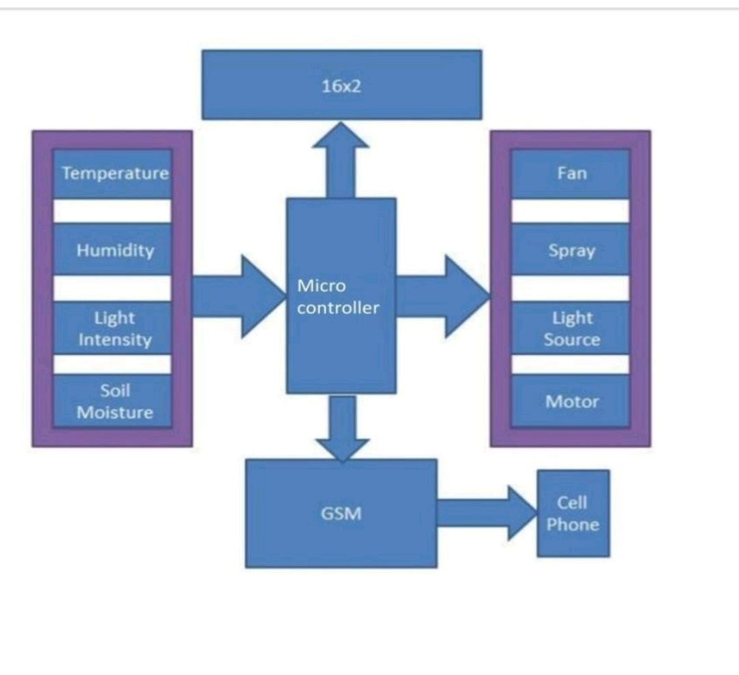
Schematic diagram

Slide 9
Micro controller
The microcontroller is the heart (or, more appropriately, the brain) of the Arduino board. The Arduino development board is based on AVR microcontrollers of different types, each of which have different functions and features. The LM35 is an integrated circuit sensor that can be used to measure temperature with an electrical output proportional to the temperature (in oC). The internal circuitry of the IC adjusts the current passing through the LEDs. LM3914 is a monolithic integrated circuit that senses analog voltage levels and drives 10 LEDs, providing a linear analog display. A single pin changes the display from a moving dot to a bar graph. Current drive to the LEDs is regulated and programmable, eliminating the need for resistors. This feature is one that allows operation of the whole system from less than 3V.A relay driver circuit is a circuit which can drive, or operate, a relay so that it can function appropriately in a circuit

Slide 10
Relay system
The driven relay can then operate as a switch in the circuit which can open or close, according to the needs of the circuit and its operation. In this project, we will build a relay driver for both DC and AC relays. Since DC and AC voltages operate differently, to build relay drivers for them requires slightly different setup. We will also go over a generic relay driver which can operate from either AC or DC voltage and operate both AC and DC relays. The HC-SR04 ultrasonic sensor uses SONAR to determine the distance of an object just like the bats do. It offers excellent non-contact range detection with high accuracy and stable readings in an easy-to-use package from 2 cm to 400 cm or 1” to 13 feet.

Slide 11
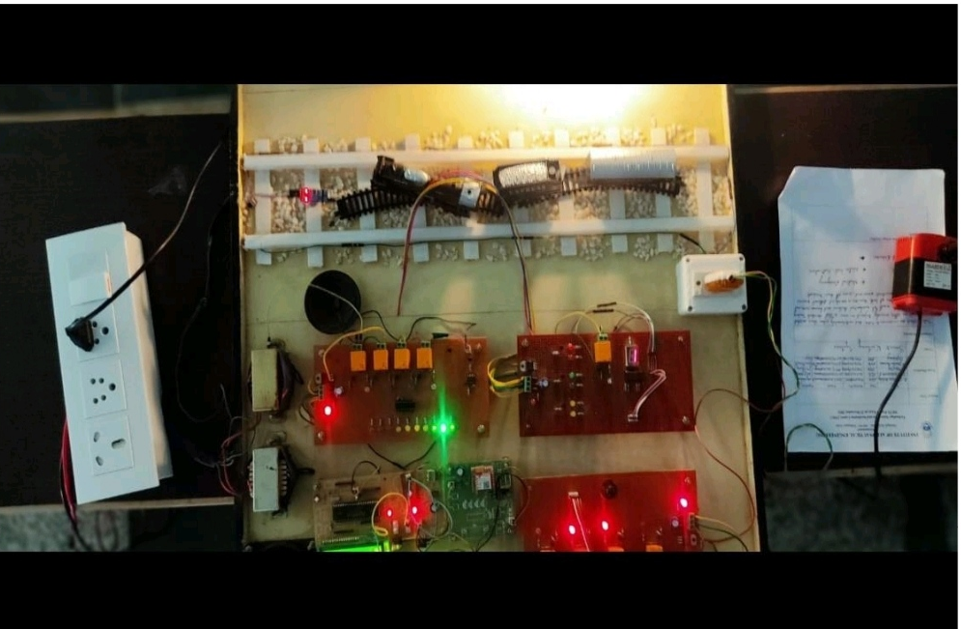
Final Product

Slide 12
Final word
The Indian railways is the world’s largest railway network covering an expanse of about 65,000kms with 23 million passengers estimated to be travelling on it everyday. Despite the magnitude of coverage of the service, the lack of basic health care facilities available to commuters is certainly a cause for concern-INDIA TOGETHER

Slide 13
THANK YOU

